Slide 1




WiseMatrix Demo
Experiment under Project MindForge
Gen AI Powered Financial Industry Risk Intelligence Engine
1
1

Slide 2















MindForge is a financial sector industry collaboration to promote adoption of responsible use of Gen AI and develop RAI* enabled Gen AI experiments
KEY WORKSTREAMS IN CURRENT PHASE
1
RESPONSIBLE GEN AI ADOPTION
In collaboration with…
Workstream 1: GEN AI Risks –Industry Whitepaper
Explore Gen AI risks and set out key infrastructure considerations for the industry
Financial Institutions
2
CREATE SYNERGISTIC VALUE
Tech Providers
Experiment with Gen AI-powered use cases to address industry challenges across risk and compliance, with Responsible AI at the core
Workstream 2: Use Case Prototypes
OUR FOCUS
Facilitators
Compliance Co-pilot
WiseMatrix
*RAI: Responsible AI
Notes:
Mindforge – financial sector industry collaboration, promote the adaption of responsible use of Gen AI and develop RAI-enabled Gen AI experiments.
The consortium of Mindforge is consisted of:
Six banks: StanC, HSBC, Citi, DBS, UOB and OCBC
Two tech providers: Google and Microsoft
Three Facilitator: MAS, Accenture and ABS
Two workstreams
WS1: Gen AI Risk, is to explore Gen AI risks and infrastructure considerations in the industry and publish an industry whitepaper
WS2: Use Case Prototyping, is to experiment with Gen AI-powered use cases to address industry challenges across risk and compliance, with Responsible AI at the core
There are two cases shortlisted among a pool of 35 Gen AI use cases and our focus here is WiseMatrix - Gen AI based risk analytics engine partnered by StanC and built on Google infra

Slide 3
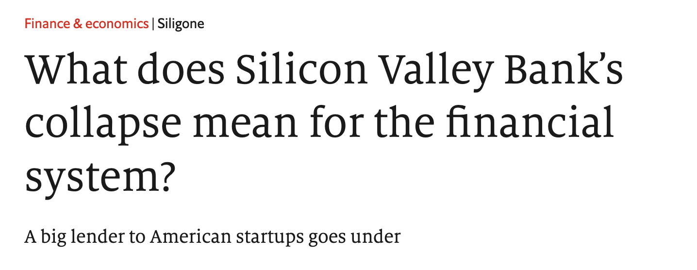
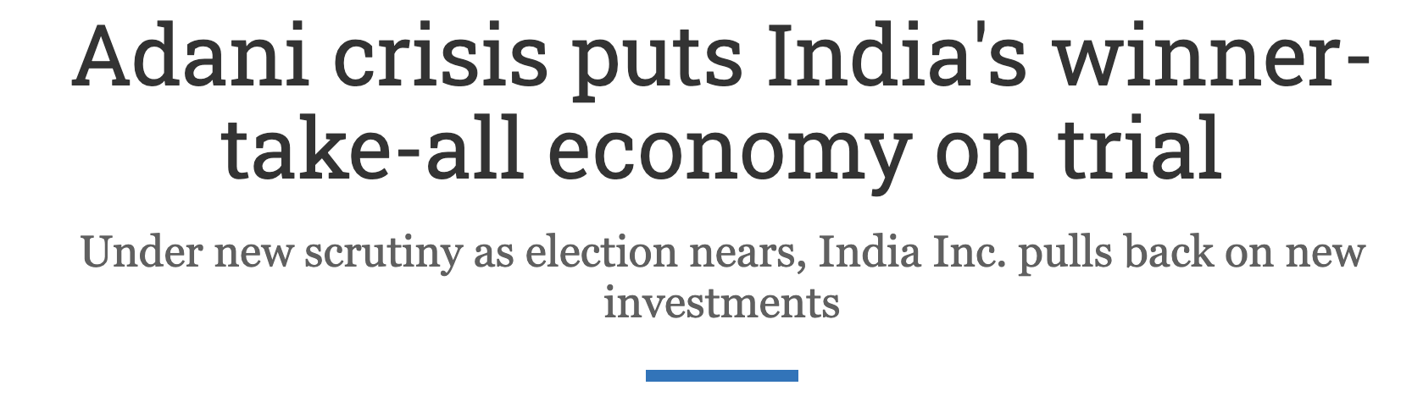
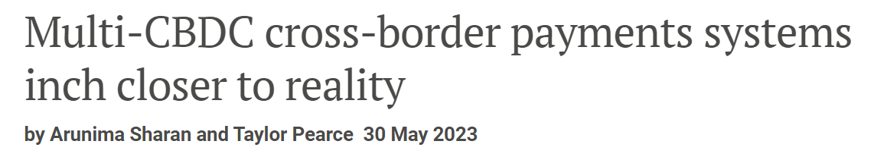
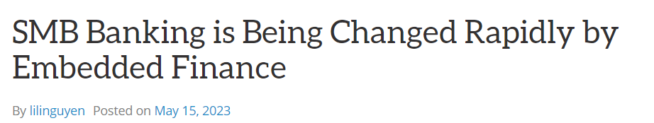
Why WiseMatrix: Historically, major Financial Crisis have been partly due to the failure to identify and manage timely hidden interconnected financial risks.
"For banks across Asia-Pacific, we now forecast credit losses of about US$425b this year and about US$440b next year. " S&P Global Ratings
The global economy experienced a cumulative loss of more than US$11 trillion from the financial crises in the past 20 years^{1.}
Industry Challenges
1
2
3
Information Volume & Human Resource Constrains
Lack of continuous monitoring & Speed of analysis
Subjectivity & Bias, and limitation of human analysis
1.6%-3.5%
of Banks’ work force in Risk Management Activities²
Scarcity & High Cost
of experienced risk analysis talents to manually conduct complex analysis on rapidly increasing volume of multi-dimensional data
Absence of continuous monitoring
to detect risks as soon as they appear
~ 3-5 days
for each banks to conduct initial assessments of external risks
~ 2-3 weeks
for each Banks full impact assessments
Cognitive Biases & Errors
due to limitations in human analysis³, leading to inaccurate risk assessment
Influence by Past Events
playing a disproportionate weight in decision making
IMF Blog. The Great Lockdown April 2020, TWP. A Guide to the Financial Crisis. September 2018
McKinsey & Company, The next frontier in risk efficiency April 2023
See: Putri, M. , Xu, C. and Akwetteh, L. (2020) Financial Behavior during COVID-19: Cognitive Errors That Can Define Financial Future.
Notes:
Background on why we are doing Wisematrix
Banks operates in a highly connected world where financial risks may be hidden and interconnected.
Every day, a large volume of news is reported from all over the world (mentions some headers). Early warning of these risk events is critical for keep bank’s asset safe from external impact.
Failure to identify early warning could incur significant loss and the collective failure on early warning in financial system would partly lead to major financial crisis.
Challenges faced
Enormous amounts of data and insufficient number of right kind of people to analyse it
Lack of continuous monitoring – Analysis happens on a reactive rather than preventive or predictive manner.
Speed of analysis is affected by human capacity
Bias and errors in analysis because of human limitation(cognitive biases and historical influence )

Slide 4



Proposed Solution: WiseMatrix Is A Gen AI Powered Knowledge Engine For Continuous Monitoring And Swift Response To External Risk Events
The engine is tested for use case specific GEN AI risk dimensions
Illustrative
INPUT
ENGINE (Individual Banks Environment)
BENEFIT
WiseMatrix
Public Domain Data
1
2
Continuous monitoring of external risk events
Shorten reaction time to external risk events
Provide inputs to help banks better manage risks
Early warnings for effective risk mitigation
Monitor & Analyze Risk Events
Guided Impact Assessment
Discovery
Knowledge Engine
Bank’s Own Data
3
Guided Portfolio Analysis
GEN AI RISK DIMENSIONS
HALLUCINATIONS
OUT OF CONTEXT
TOXICITY / BIAS
Notes:
To overcome these challenges. We have proposed a solution (Wise Matrix)
This is a Gen AI powered Risk analytics engine for continuous monitoring and swift response to risk events
What do we do here:
Input data consists of public domain data (News) and Bank's own data (such as portfolio and policy controls)
This engine will operate in individual bank in such a way as to monitor and analyze external risk events, analyze portfolio impact and policy triggers.
By doing this, we are able to achieve the following benefits
Continuous monitoring
Shorted reaction time
Help manage risks
Early warning for action
While enjoying those great benefits from WiseMatrix, we are also vigilant in putting guardrails on Toxicity/Bias, Hallucination and Out of Context, as advised by our industry whitepaper on responsible use of gen ai

Slide 5
WiseMatrix: Performance on Accuracy
WiseMatrix leverages Retrieval Augmented Generation (RAG) to supplement PaLM2 text generation with the context from Vector Search, for improving context-aware accuracy and reducing hallucination.
 |  | WiseMatrix | Foundation Model
StanC' OT | Standard Chartered Objective Testing | 85% (47/55) | 25% (14/55)
StanC' AT | Standard Chartered Additional Testing | 70% (42/60) | 33% (20/60)
ACN' T | Accenture Testing | 92% (33/36) | 31% (11/36)
total | All Three Testing Sets | 81% (122/151) | 30% (45/151)
Notes:
WiseMatrix leverages Retrieval Augmented Generation (RAG) to supplement PaLM2 text generation with the context from Vector Search, for improving context-aware accuracy and reducing hallucination
We conducted 3 rounds of tests to demonstrate the improvement on context-aware accuracy.
During the test, we sent the queries specific to the input news on financial risks to both Wisematrix and foundation model, and compared the accuracies of the responses through human validation
We have three sets of use cases
Two from Stan C
Objective Testing
Additional test cases
One set from Accenture
As shown in the result chart, with the context supplement from news and portfolio data, Wisematrix outperforms the foundation model in every single test with significant margin, and no hallucination has been observed in the responses from WiseMatrix.

Slide 6
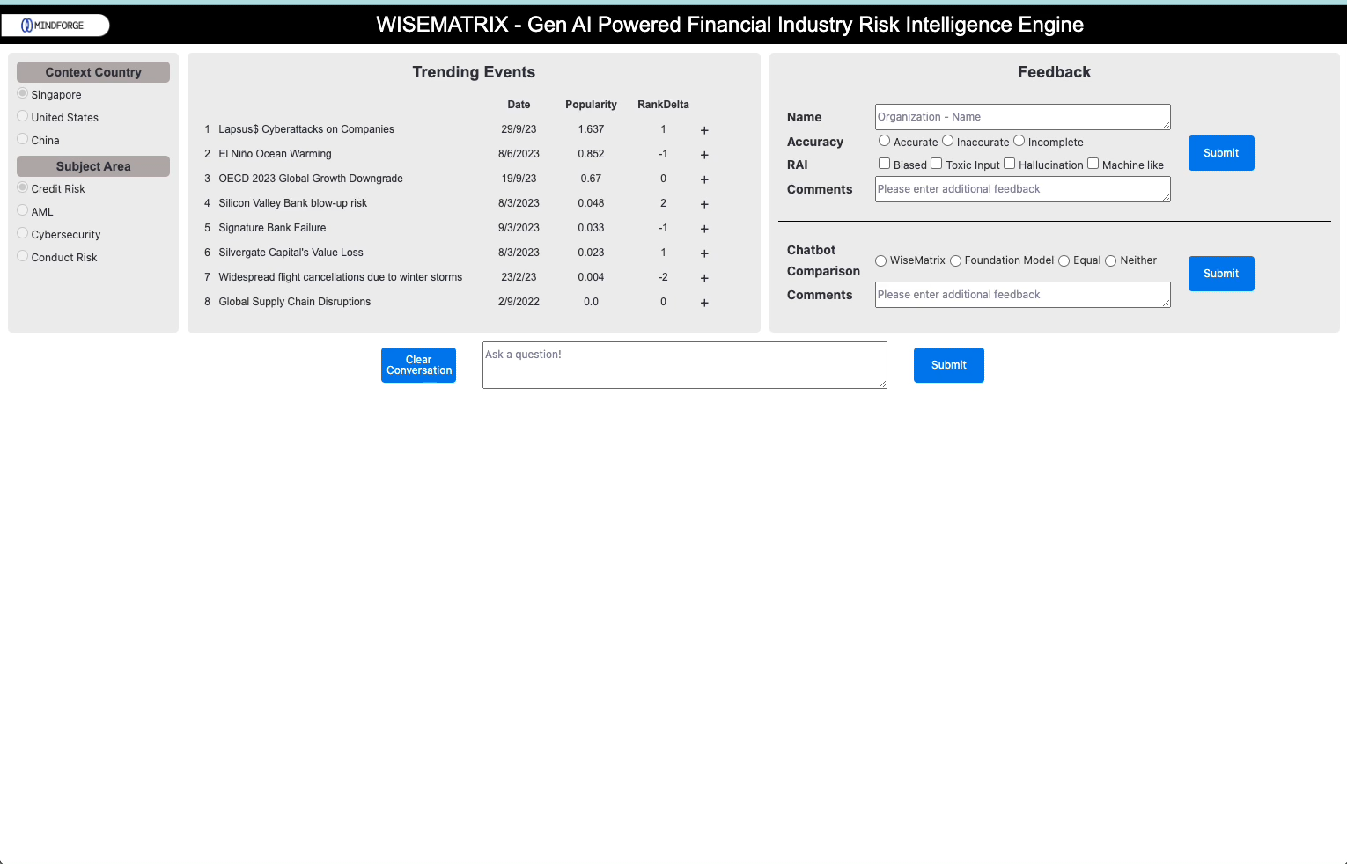
WiseMatrix: Demo
Notes:
Welcome to the demo!
In the home page, you will find filters to select context country and subject area.
Context Country – Used to filter public policies.
Subject Area – Used to filter news.
Trending events: Ranked based on popularity (Score was calculated using recency and frequency). Shows the date and delta of the rank. Once you click on the “+” button, a pop-up shows source of the relevant news. You can click on the links to visit the actual news page.
Question 1: “What happened in the Silicon Valley bank collapse?”
The system will process and give you and answer compared with the foundation model’s answer. You can further click on citation to see which documents were used as references.
foundation model – Hallucinated.
Question 2: Asking follow-up questions. “What are the banks or financial institutions that failed or collapsed in 2023?”
They system can use the memory to understand the topic from previous questions and look for appropriate answers. This question also digests multiple sources to come up with a relevant answer.
Feedback – Comments and feedback can be given by the user which will be used to improve the tool.
Clear conversation - To clear memory and start new topics.
Question 3: “What are the impacts of the global slowdown?”
The question sounds generic, and you can see that Wisematrix uses targeted info to answer. You can also see that foundation model result is generic since it doesn’t have access to the specific information.
Question 4: “What are the accounts affected by supply chain disruptions and why?”
The system has access to details from portfolio. The portfolio contains simulated data from 66 accounts. The system understands the impact of the event from the news and then finds relevance in those simulated accounts and retrieves relevant accounts along with reasons.
Question 5: “Is it possible for gold mountain bank to get a credit downgrade from the Silicon Valley bank collapse?”
The question refers to Gold mountain bank. (This is a simulated bank with business characteristics like SVB). The objective of the question was to test if Wisematrix can alert us if it can identify risk for Gold Mountain bank since an event like SVB collapse has happened.
Wisematrix investigates the news and portfolio data and is able to answer relevantly.
RAI – When foul or toxic languages are used, the tool doesn’t accept the question and asks to enter again.

Slide 7
Thank You Stay tuned for the release of the whitepaper early 2024

